Slide 1
Cloth Simulation
Fang Hao
Nanjing University

Slide 2
Outline
Motivation and Application
Cloth Simulation Methods
  Physically-based Cloth Simulation
Reference

Slide 3
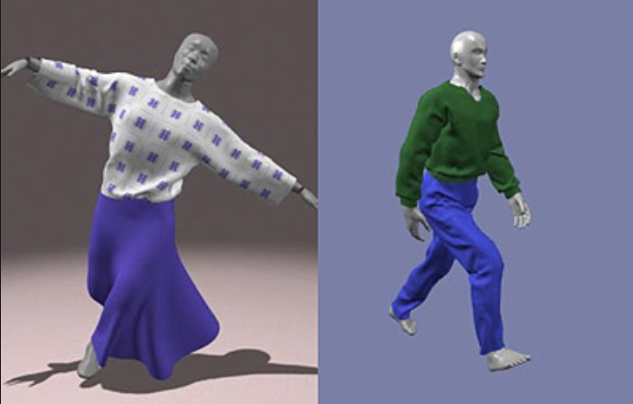
Motivation & Application
Movies
Games
VR Scene
Virtual Try-on
Garment Design

Slide 4
Cloth Simulation Methods
Geometric Method
  Represent folds and creases by geometrical equations
  Aim at modeling the appearance of the cloth
  Not focus on the physical aspects of cloth
Physically-based Method

Slide 5
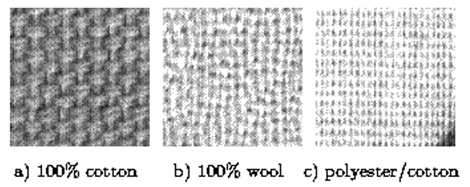
Particle-based Model
Cloth fibers and crossings
Approximated by mass-spring particle model

Slide 6
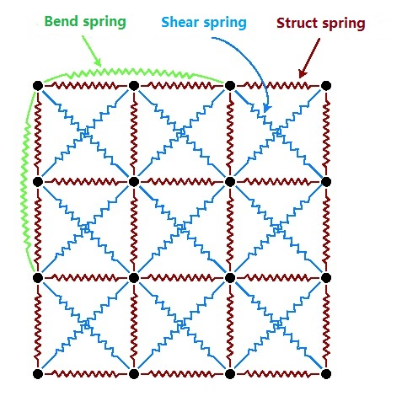
Mass-spring Particle Model
Struct spring:
connect p[i,j] and p[i+1,j], p[i,j] and p[i,j+1]
Shear spring:
connect p[i,j] and p[i+1,j+1], p[i+1,j] and p[i,j+1]
Bend spring:
connect p[i,j] and p[i+2,j], p[i,j] and p[i,j+2]

Slide 7
Physically-based Simulation
1. Finding Energy Equation
2. Solving the Equations
3. Collision Detection / Handling

Slide 8
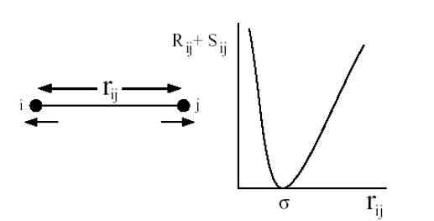
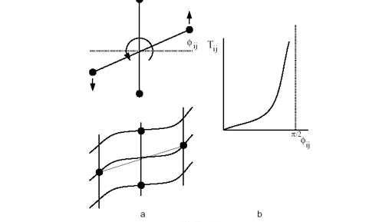
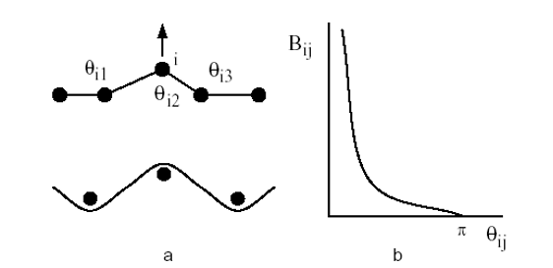
Energy Equation
Struct
Shear
Bend

Slide 9


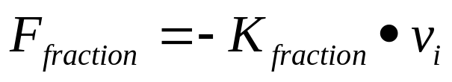
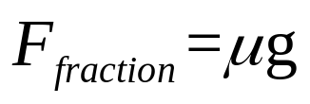
Energy Equation
Hooke’s law:

Slide 10
Solving the Equations
Explicit Euler
Implicit Euler
Verlet integration
Implicit integration

Slide 11
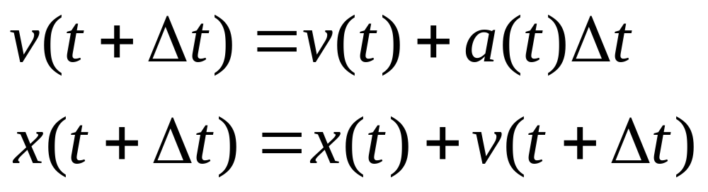
Explicit Euler
X(t)/X(t+Δt) : Point position at time t / t+Δt
v(t)/v(t+Δt) : Point speed at time t / t+Δt
a(t) : Point acceleration at time t

Slide 12
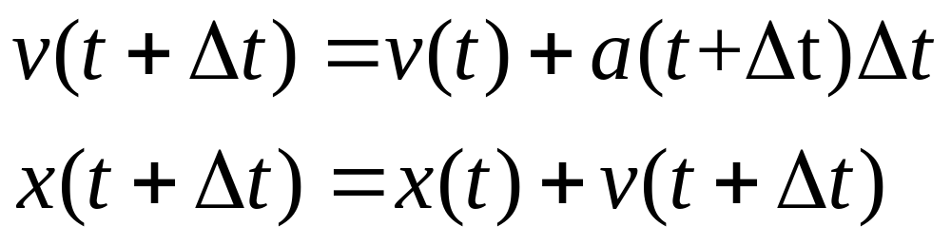
Implicit Euler
X(t)/X(t+Δt) : Point position at time t / t+Δt
v(t)/v(t+Δt) : Point speed at time t / t+Δt
a(t+Δt) : Point acceleration at time t+Δt

Slide 13
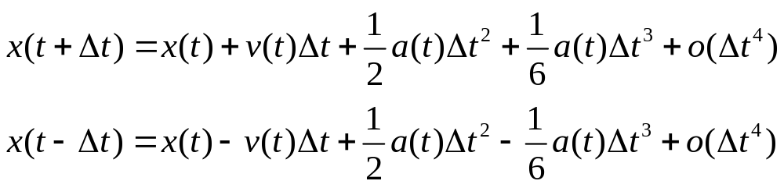
Verlet integration
（1）
（2）
（1）+（2）：

Slide 14
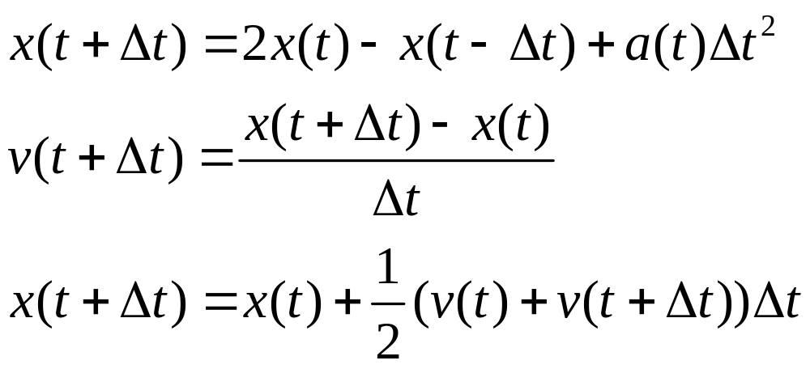
Implicit integration

Slide 15
Collision Detection / Handling
Collision Detection:
  Cloth-cloth: particle-triangle and edge-edge intersection
  Cloth-solid: cloth particle against the faces of solid object
Collision Response:
  Cloth-cloth: insert a strong damped spring force to push the cloth apart
  Cloth-solid: if the relative tangential velocity is low,lock the particle onto the surface;if not allow the particle to slide on the surface

Slide 16
References
Meng Y，Mokb P Y，Jin X． Interactive virtual try-on clothing design systems［J］ ． Computer-Aided Design． 2010，42( 4) : 310-321
Volino P， Magnenat-Thalmann N， Faiire F． A simple approach to nonlinear tensile stiffness for accurate cloth simulation［J］ ． ACM Transactions on Graphics，2009，28( 4) : 104．
Zhang M M，Pan Z G，Mi Q Ｒ． Anisotropic cloth modeling for material fabric［J］ ． Transactions on Edutainment IV，2010( 4) : 130-144

Slide 17
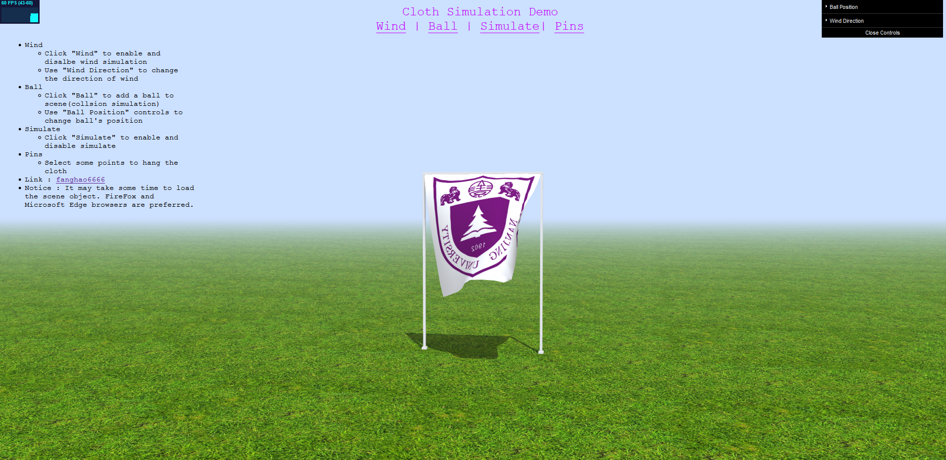
Online Demo
http://fanghao.site/OnlineDemos/Cloth-Simulation/index.html

